Slide 1
Surgical Procedures
Images and information from: https://www2.aofoundation.org/wps/portal/surgery

Slide 2
Procedures We Are Implementing
Radius Fracture
Options will be Short Plate vs. Long Plate
Hip Replacement
Options will be IM Nail vs. Joint Replacement

Slide 3
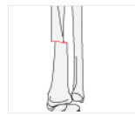
Navigating the Site to Radius Fracture
Forearm shaft
Radius
Transverse
Compression Plating
Proceed

Slide 4
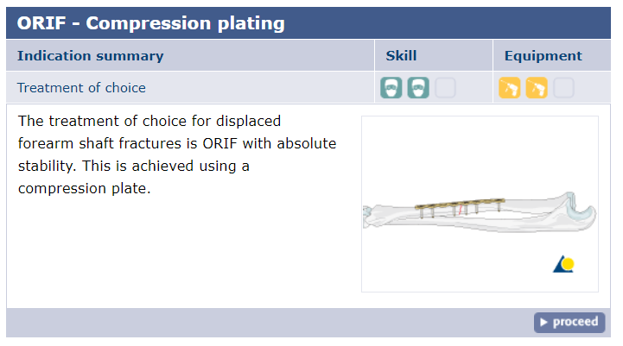
ORIF Compression Plating
This is correct technique/procedure

Slide 5
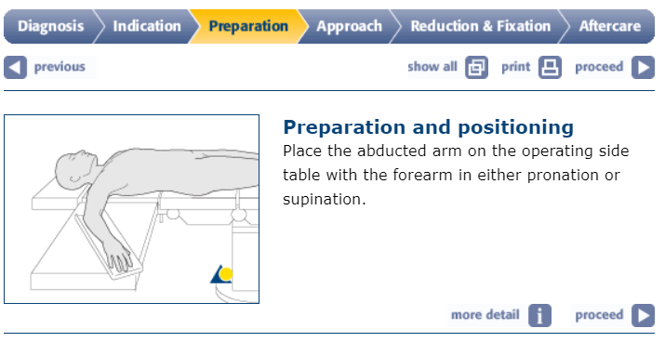
Preparation
Don’t focus on this too much, just place the patient

Slide 6
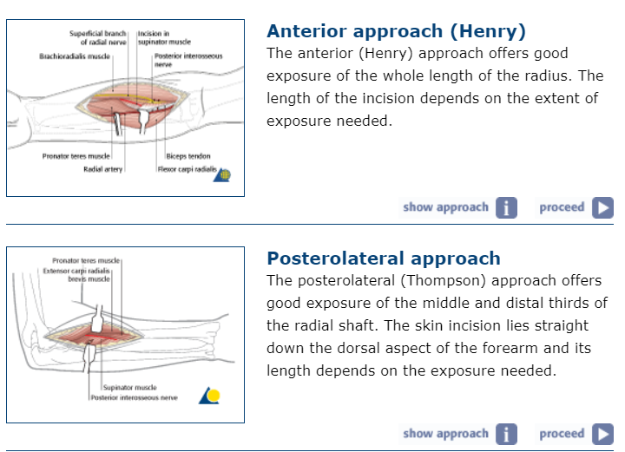
Approaches
Which approach
should we use?
Use Henry approach

Slide 7
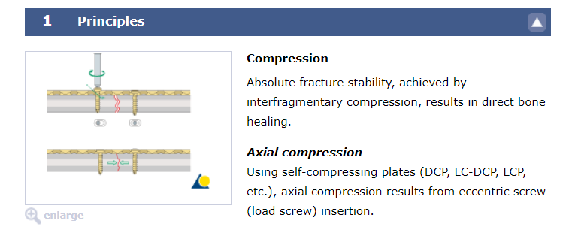
Anterior Approach (Henry)

Slide 8
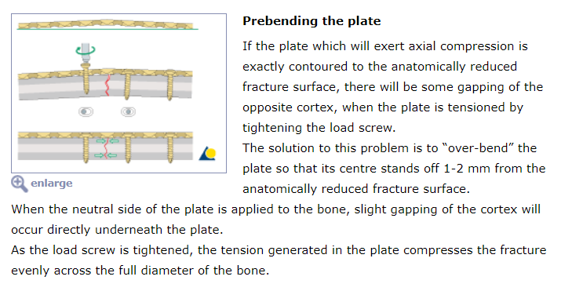
Do we need to include prebending the plate?

Slide 9
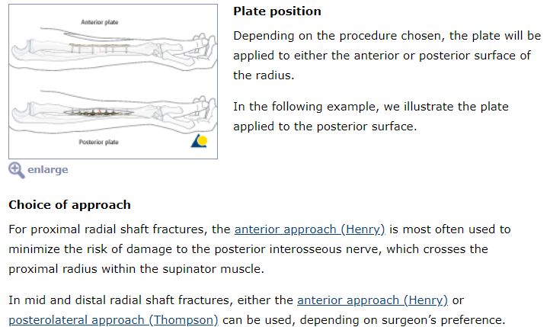

Slide 10
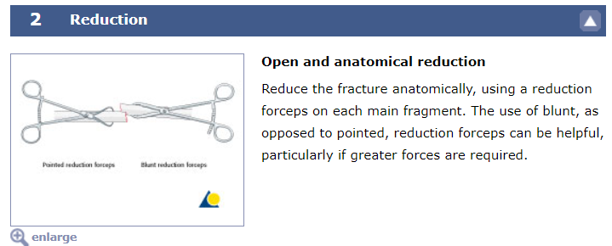
Reduction: what is this and how much/what do we need to do?

Slide 11
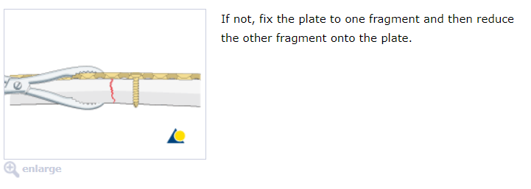
More reduction

Slide 12
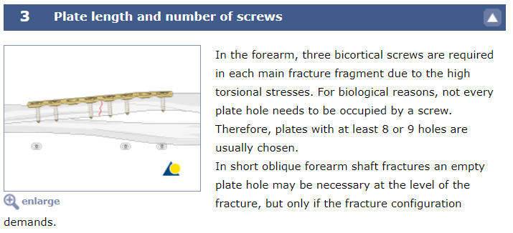
Plate length and number of screws… how to we know which holes to occupy or how many?

Slide 13
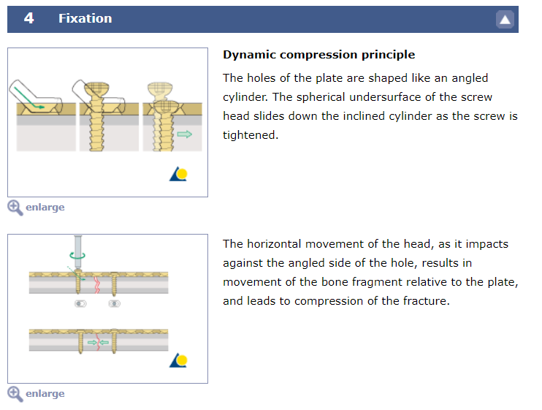
Fixation

Slide 14
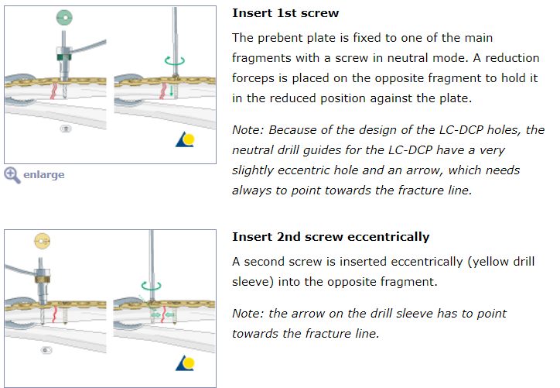
Inserting Screws

Slide 15
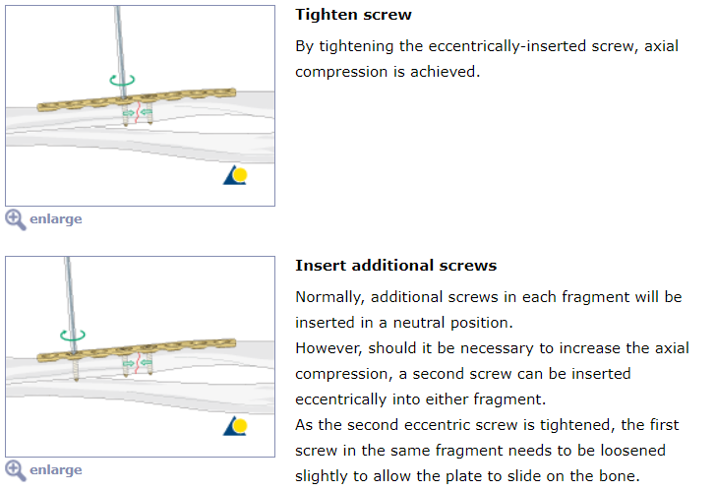
More fixation

Slide 16
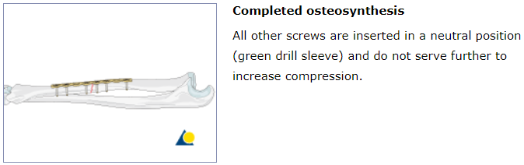
Osteosynthesis

Slide 17
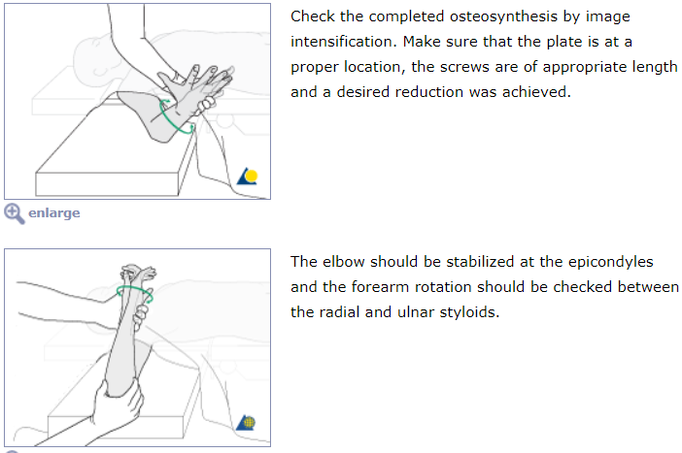
Check of Osteosynthesis

Slide 18
Questions on Radial Fracture
What are the lengths of the plates? Short and long, and which one is correct?
What number of screws and what placement?
Do we need to prebend the plate or can this be something implemented in the future for a more complex scenario?

Slide 19
Navigating to Hip Replacement
Proximal Femur
Pertrochanteric, simple
Nailing
I’m guessing this is the correct approach and specific injury(we can ask them!)
The second option is hip replacement, which can be found:
Proximal femur
Subcapital displacement
arthroplasty

Slide 20
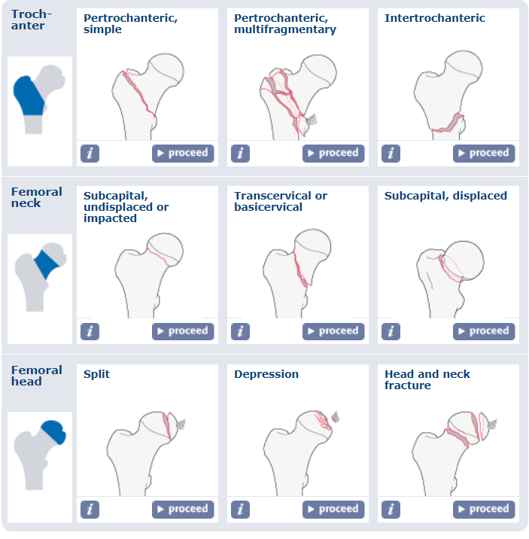
Proximal Femur Injuries:

Slide 21
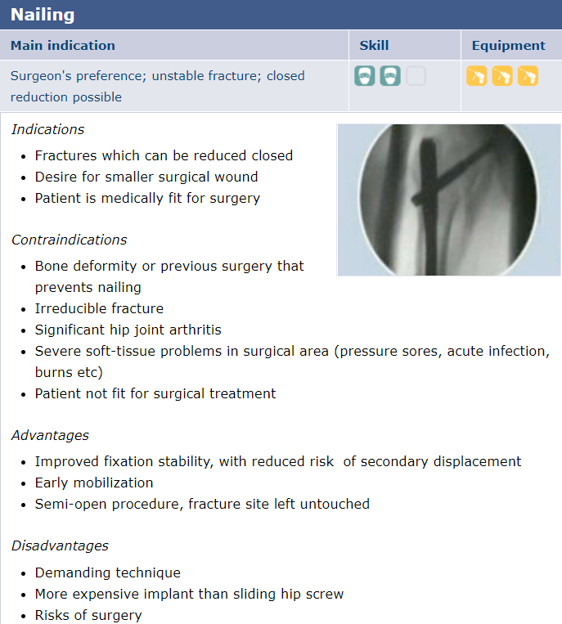
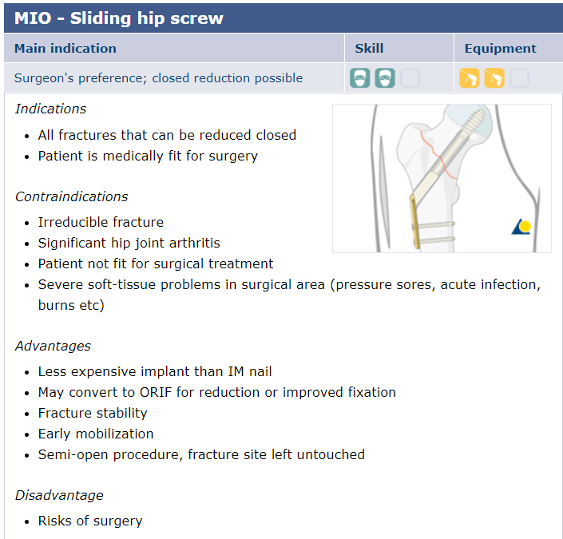
Pertrochanteric, simple

Slide 22
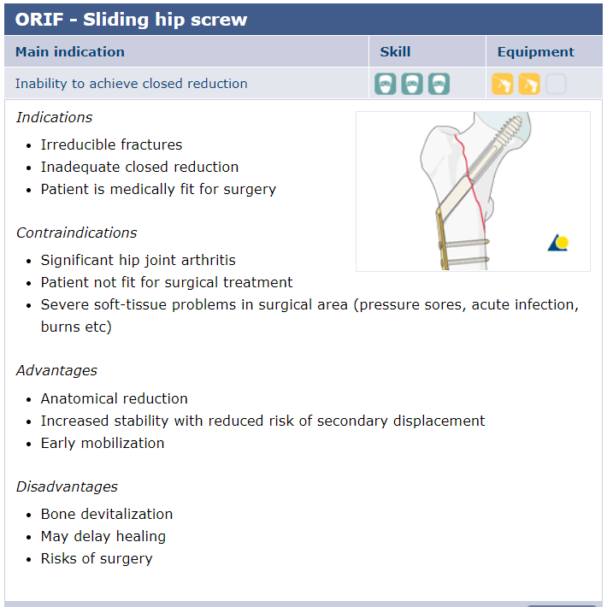
Third technique

Slide 23
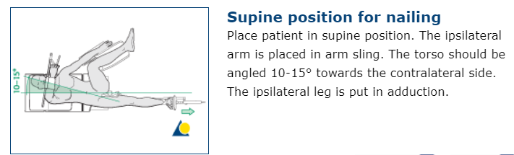
Preparation

Slide 24
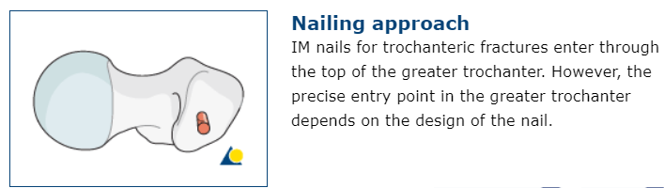
Approach

Slide 25
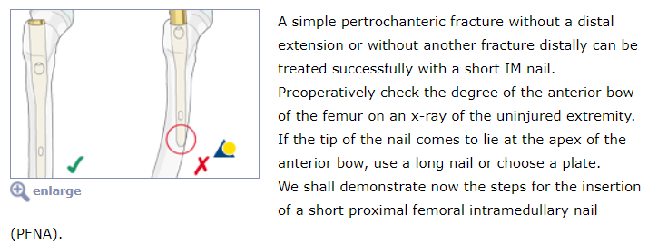

Slide 26
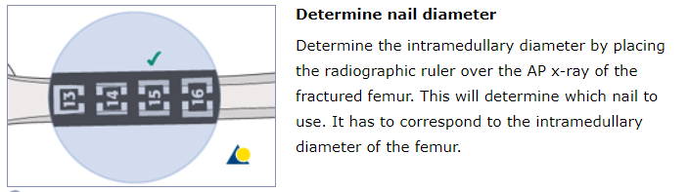

Slide 27
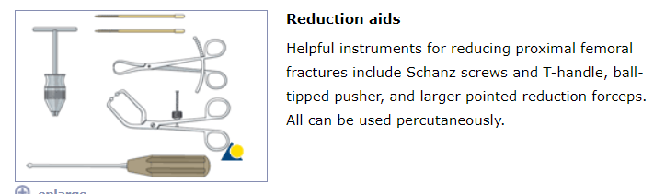

Slide 28
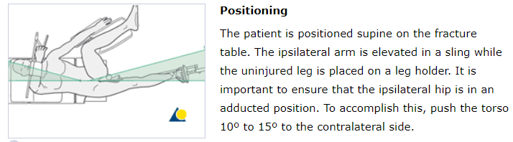

Slide 29
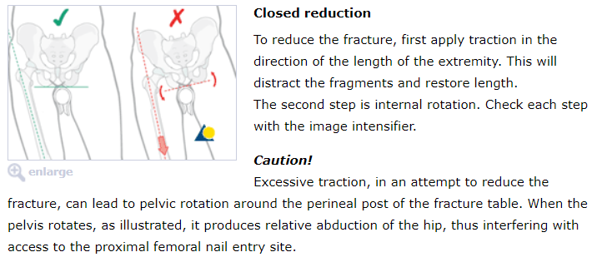

Slide 30
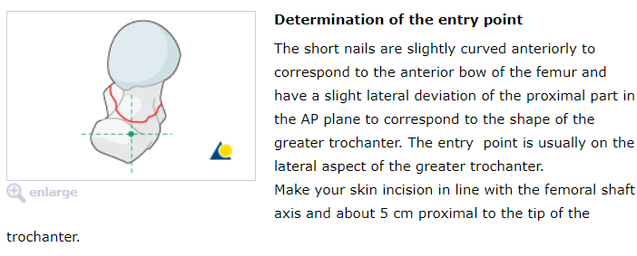

Slide 31
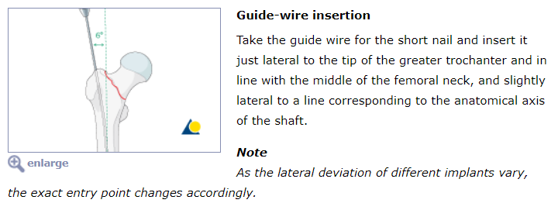

Slide 32
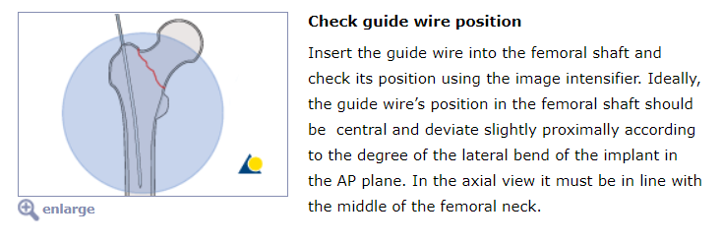

Slide 33
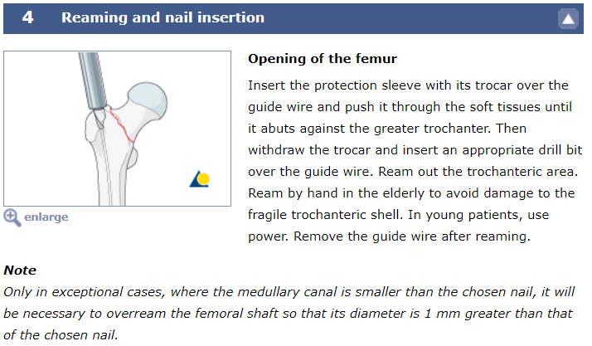

Slide 34
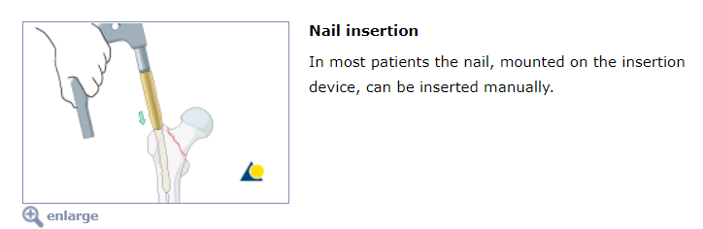

Slide 35
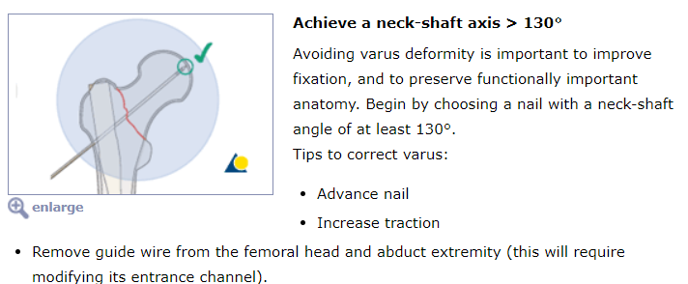

Slide 36
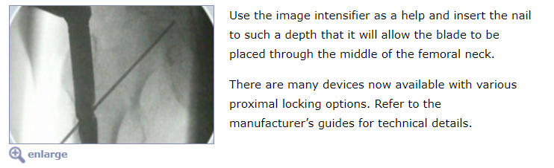

Slide 37
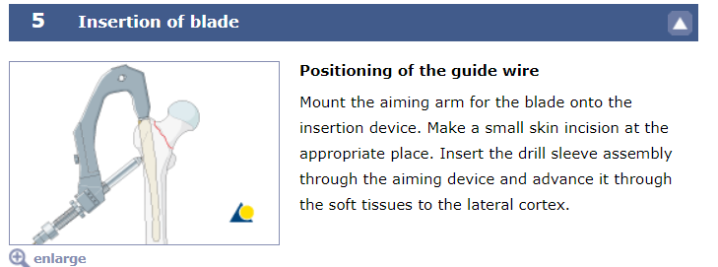

Slide 38
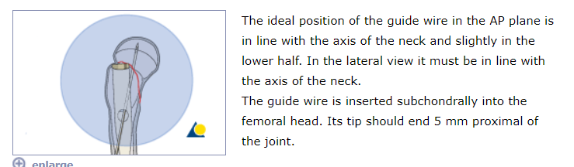

Slide 39
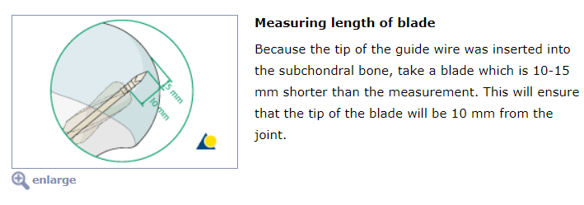

Slide 40
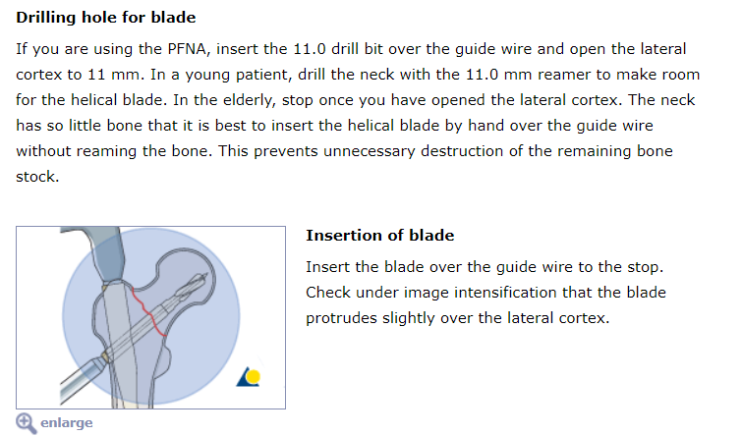

Slide 41
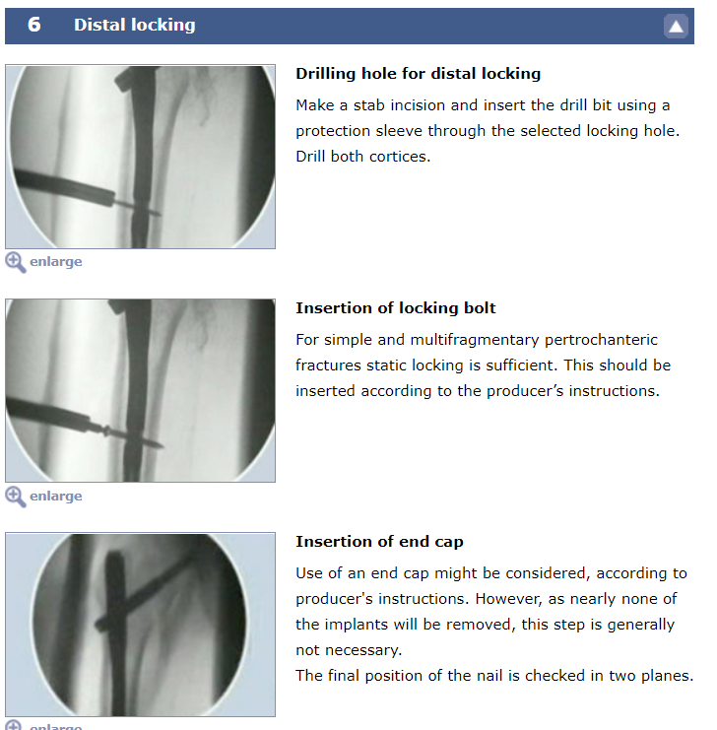

Slide 42

Joint Replacement - wrong procedure?

Slide 43
Questions
Are these the right procedures, injuries, and options?
What parts of this do you need included?
What is the length of nails and other parts?
How cartoonish would you like the game to be?

